Slide 1
LIFE Oak Processionary
Mid-term conference 05/10/2023, Sittard-Geleen
Preliminary conclusions - Where are we after 2,5 years?

Slide 2
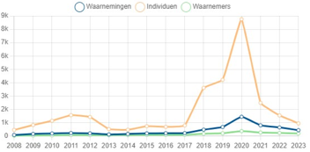
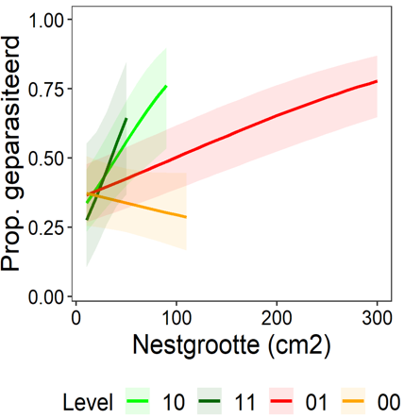
Where are we after 2,5 years? (1/2)
Trend Oak Processionary: 2023 quiet, 2024 comparable?
Predation by tits:
No clear impact of tits on oak processionary caterpillars yet;
Tit chicks too late in the season to take advantage of young caterpillars;
Research continues.
Predation by parasitoid flies and wasps:
Promising results in terms of impact on the oak processionary caterpillar;
No clear connection yet with the type of road verge, management or nectar index;
Research is refined into plant species and continued.

Slide 3
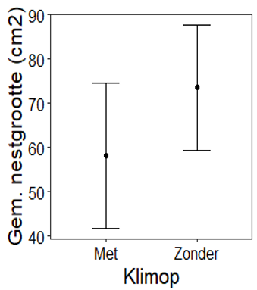
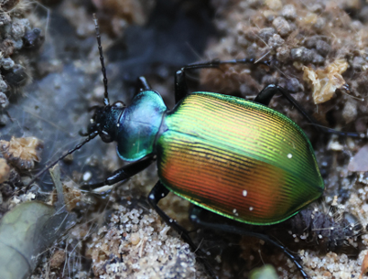
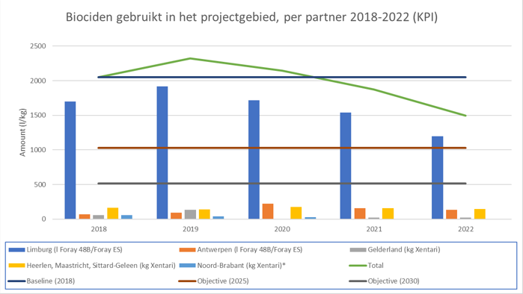
Where are we after 2,5 years? (2/2)
Common ivy in pedunculate oak:
First results show a significant impact on oak processionary caterpillars;
Research continues;
Possible impact on other species is being investigated.
Predation by forest caterpillar hunter:
Lab tests show that they prefer oak processionary caterpillars as food;
If a breeding can be started, we see possibilities for controlling the caterpillars;
Further research in the laboratory and then outside (if there are sufficient caterpillars) is certainly necessary;
Currently, the population of beetles in the Benelux is too small to have an impact.
Biocide use in Flanders & the Netherlands:
Decreases almost everywhere in Flanders and the Netherlands since 2021;
Risk of relapse when pressure increases -> awareness remains important.

Slide 4
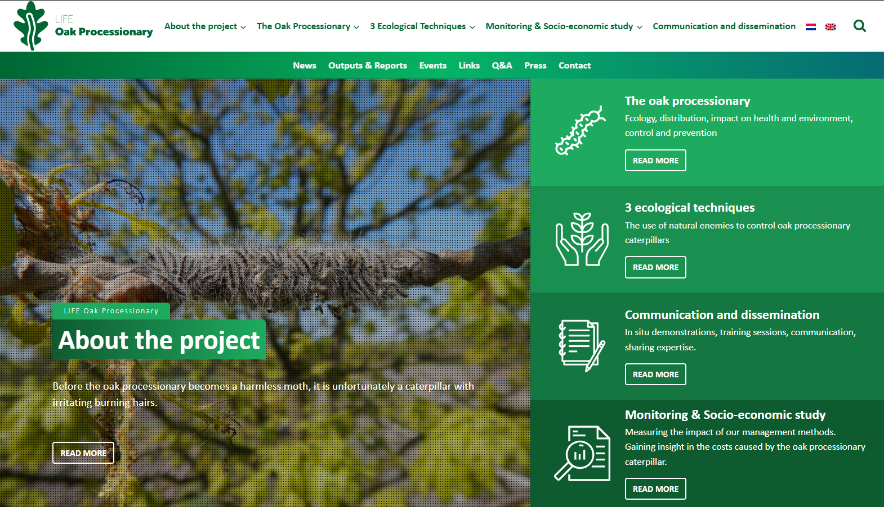
More info? Questions? Comments?
Website: Home - LIFE Oak Processionary Project
Facebook: EikenprocessierupsLIFE
E-Mail: info@eikenprocessierups.life

