Slide 1
LIFE Oak Processionary
Midterm conference 05/10/2023, Sittard-Geleen

Slide 2
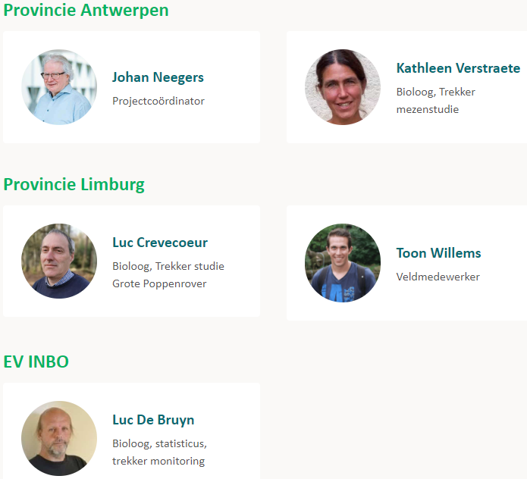
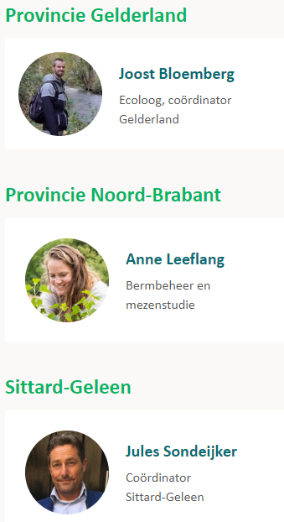
The Project Team

Slide 3
Day Program

Slide 4
Agenda
Is the Oak Processionary Moth declining?
Ecological control of the Oak Processionary Moth
Tits as natural predators
Road verge management, parasitoid flies and wasps
Common Ivy - An unexpected sidestep
The Forest Caterpillar Hunter, back with a vengeance
Biocide use in Flanders and the Netherlands – on the way to a drastic reduction?

Slide 5
Agenda
Is the Oak Processionary Moth declining?
Ecological control of the Oak Processionary Moth
Tits as natural predators
Road verge management, parasitoid flies and wasps
Common Ivy - an unexpected sidestep
The Forest Caterpillar Hunter, back with a vengeance
Biocide use in Flanders and the Netherlands – on the way to a drastic reduction?

Slide 6
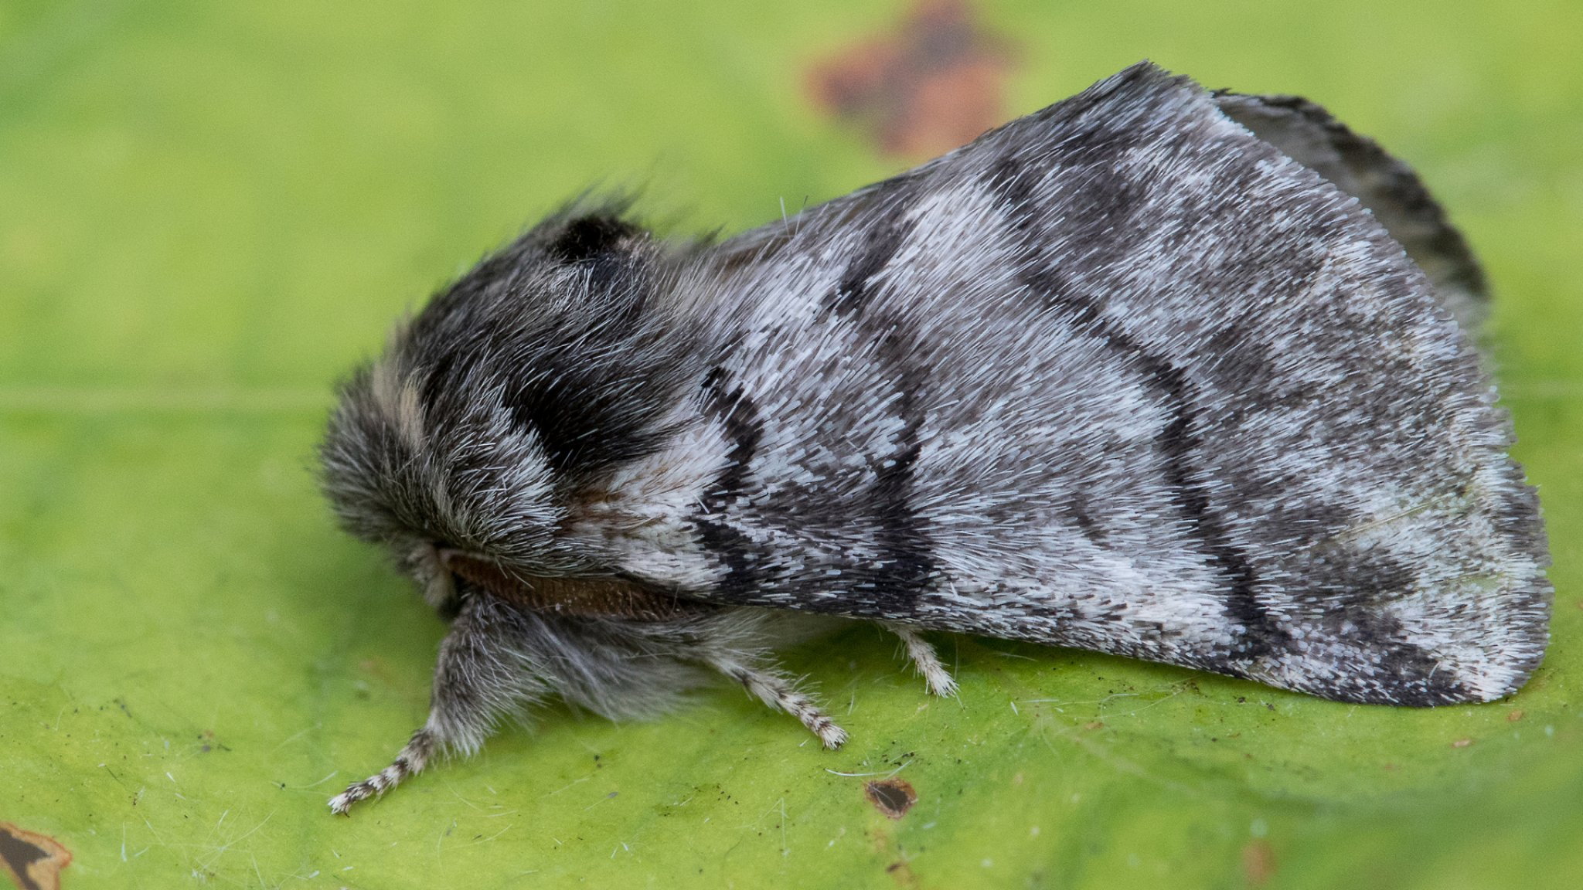
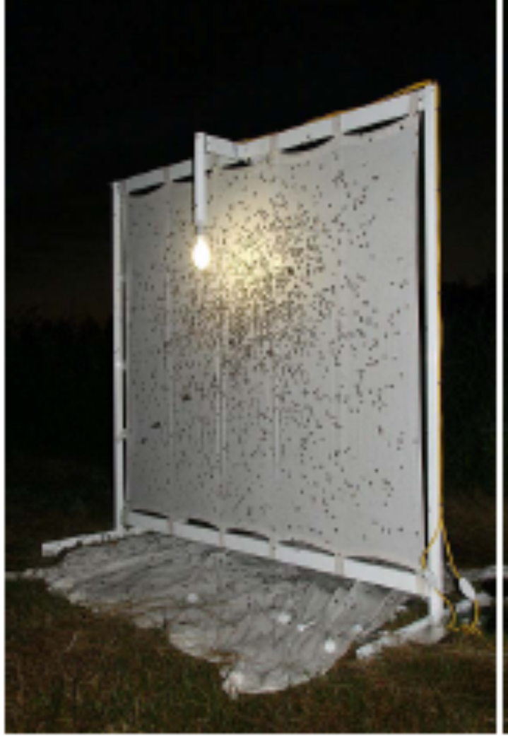
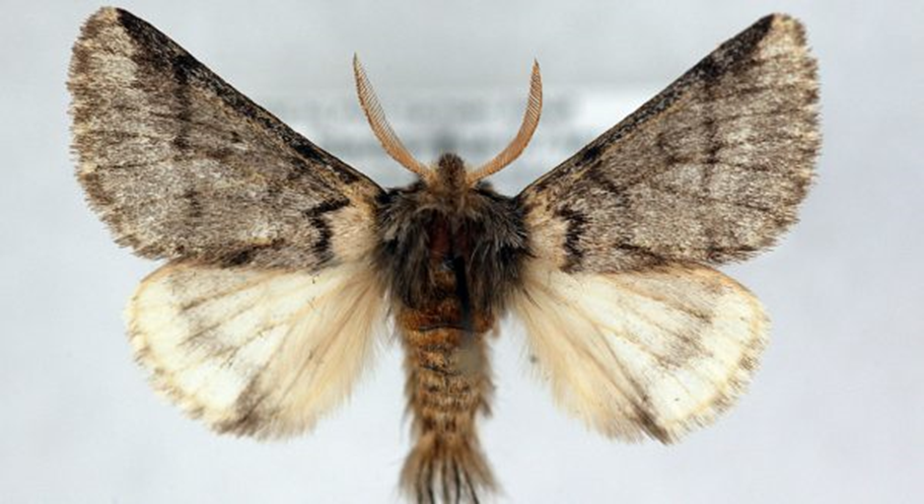
Is the Oak Processionary Moth (OPM) declining????

Slide 7
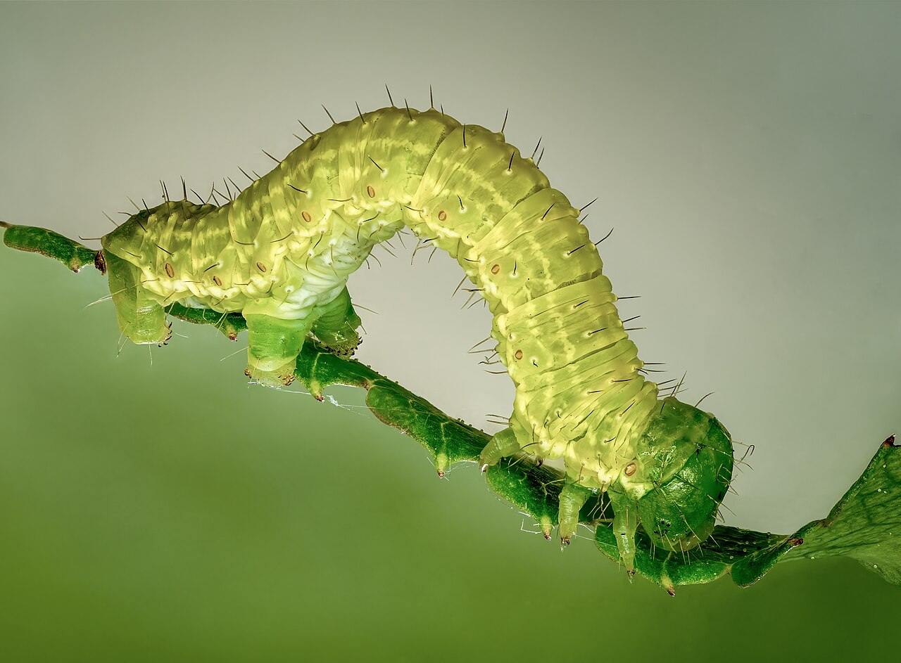
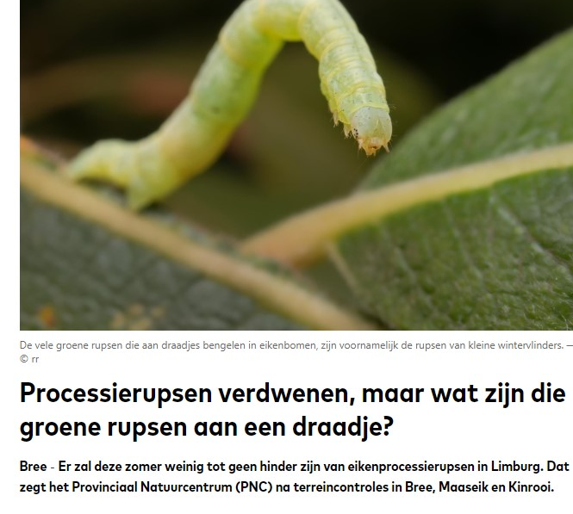
Wikipedia C Reinhold Möller

Slide 8
Observations in Belgium

Slide 9
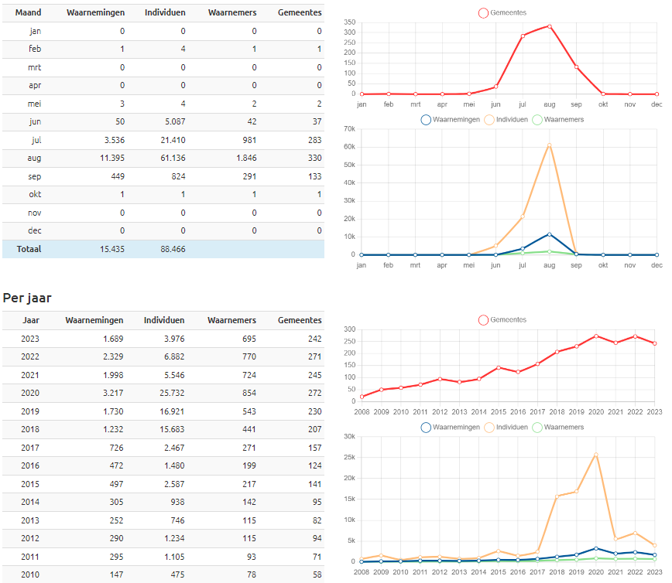
Observations in the Netherlands

Slide 10
Less moths?
2023 records
2022 records
Weert Kettingdijk 50 Roosendaal 15 Stokkum 16
Ellikom 17 Kalmthout 35
De Hamert 60 Strijbeek 55 Winterwijk 30
Bree 35 Geel 60

Slide 11
Average numbers per light trap
Nederland
België
2018 8,8
2019 9,5
2020 7,5
2021 2,5
2022 2,5
2023 2,2
2018
2019 6,2
2020 6,0
2021 3,1
2022 2,4
2023 2,1

Slide 12
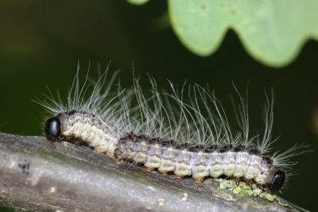
efährliche Insekten:Ein schlechtes Jahr für den Eichenprozessionsspinner
5. Juni 2023, 10:58 Uhr
Lesezeit: 2 min

Slide 13
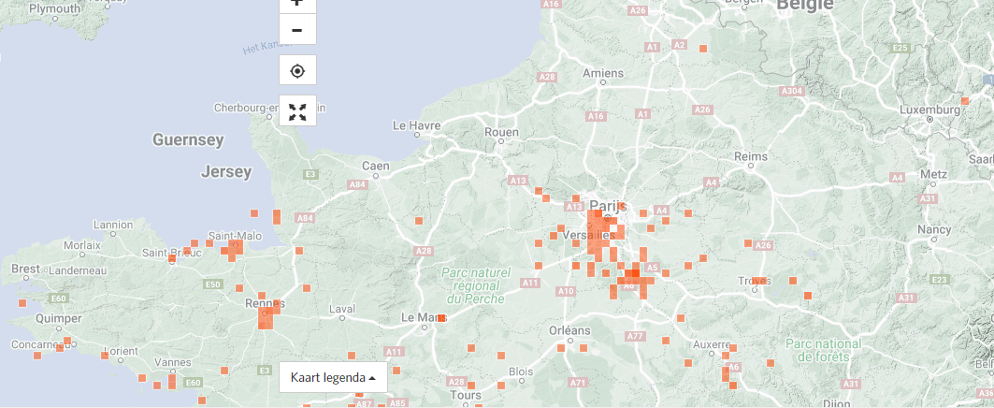
Pine Processionary moth

Slide 14
Preliminary Conclusions
2023 is a year with little Oak Processionary Moths
Expectations for 2024 are similar

Slide 15
Agenda
Is the Oak Processionary Moth declining?
Ecological control of the Oak Processionary Moth
Tits as natural predators
Road verge management, parasitoid flies and wasps
Common Ivy - an unexpected sidestep
The Forest Caterpillar Hunter, back with a vengeance
Biocide use in Flanders and the Netherlands – on the way to a drastic reduction?

Slide 16
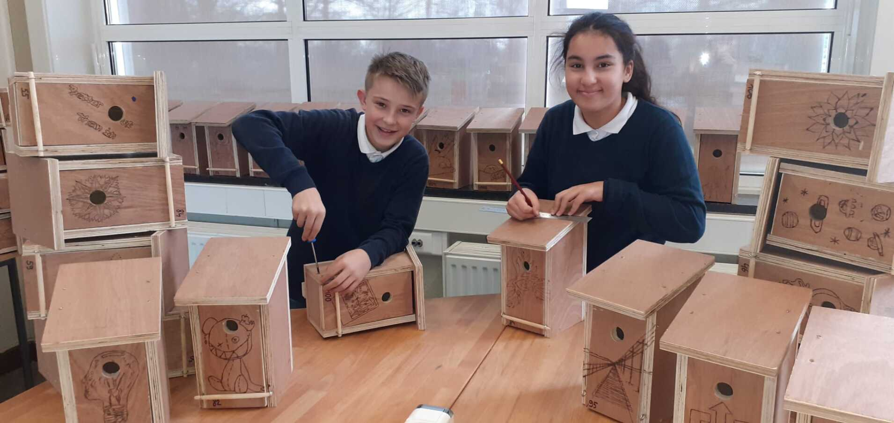
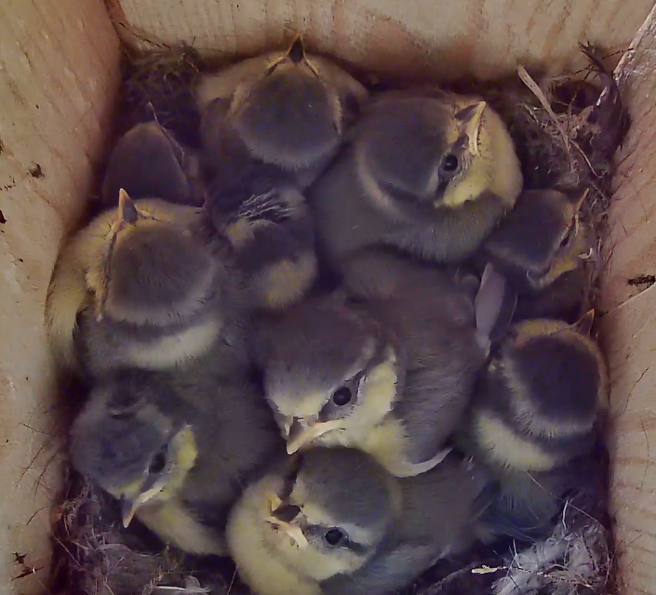
Tits as natural predators
Study: 48 test locations spread over 4 provinces (Antwerpen, Limburg, N-Brabant, Gelderland)
Per province, 12 locations, 6 with and 6 without nest boxes

Slide 17
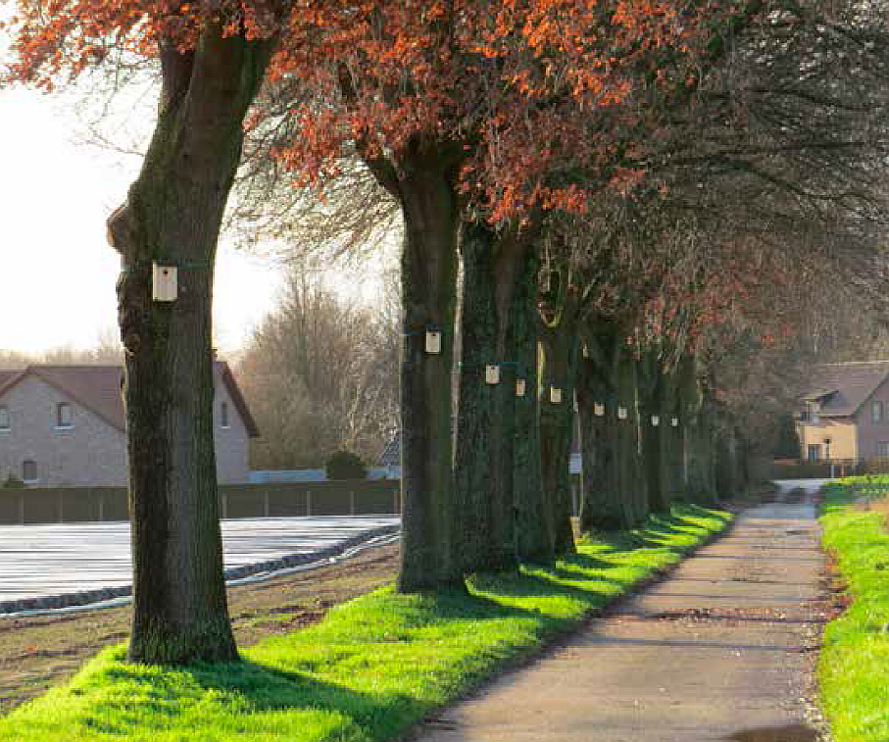
Tits as natural predators
Per location, 15 infected trees provided with a nest box
360 nest boxes in total

Slide 18
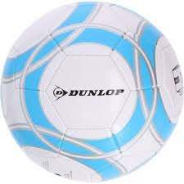
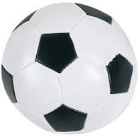
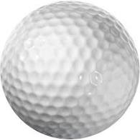
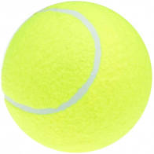
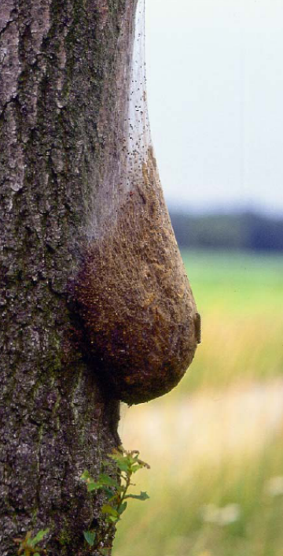
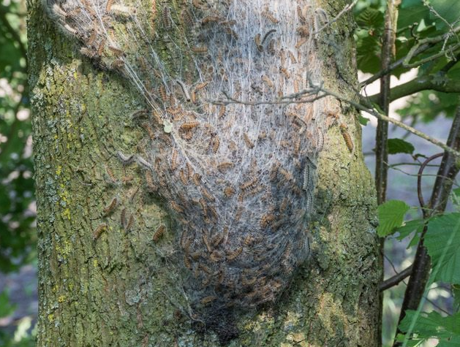
Densities
basket
soccer
hand
pipo
golf
tennis
Nest size
3 cm
4 cm
7 cm
15 cm
20 cm
40 cm

Slide 19
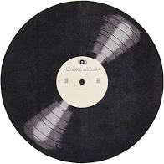
Densities
Nest size
Disc-shaped
X cm x Y cm

Slide 20
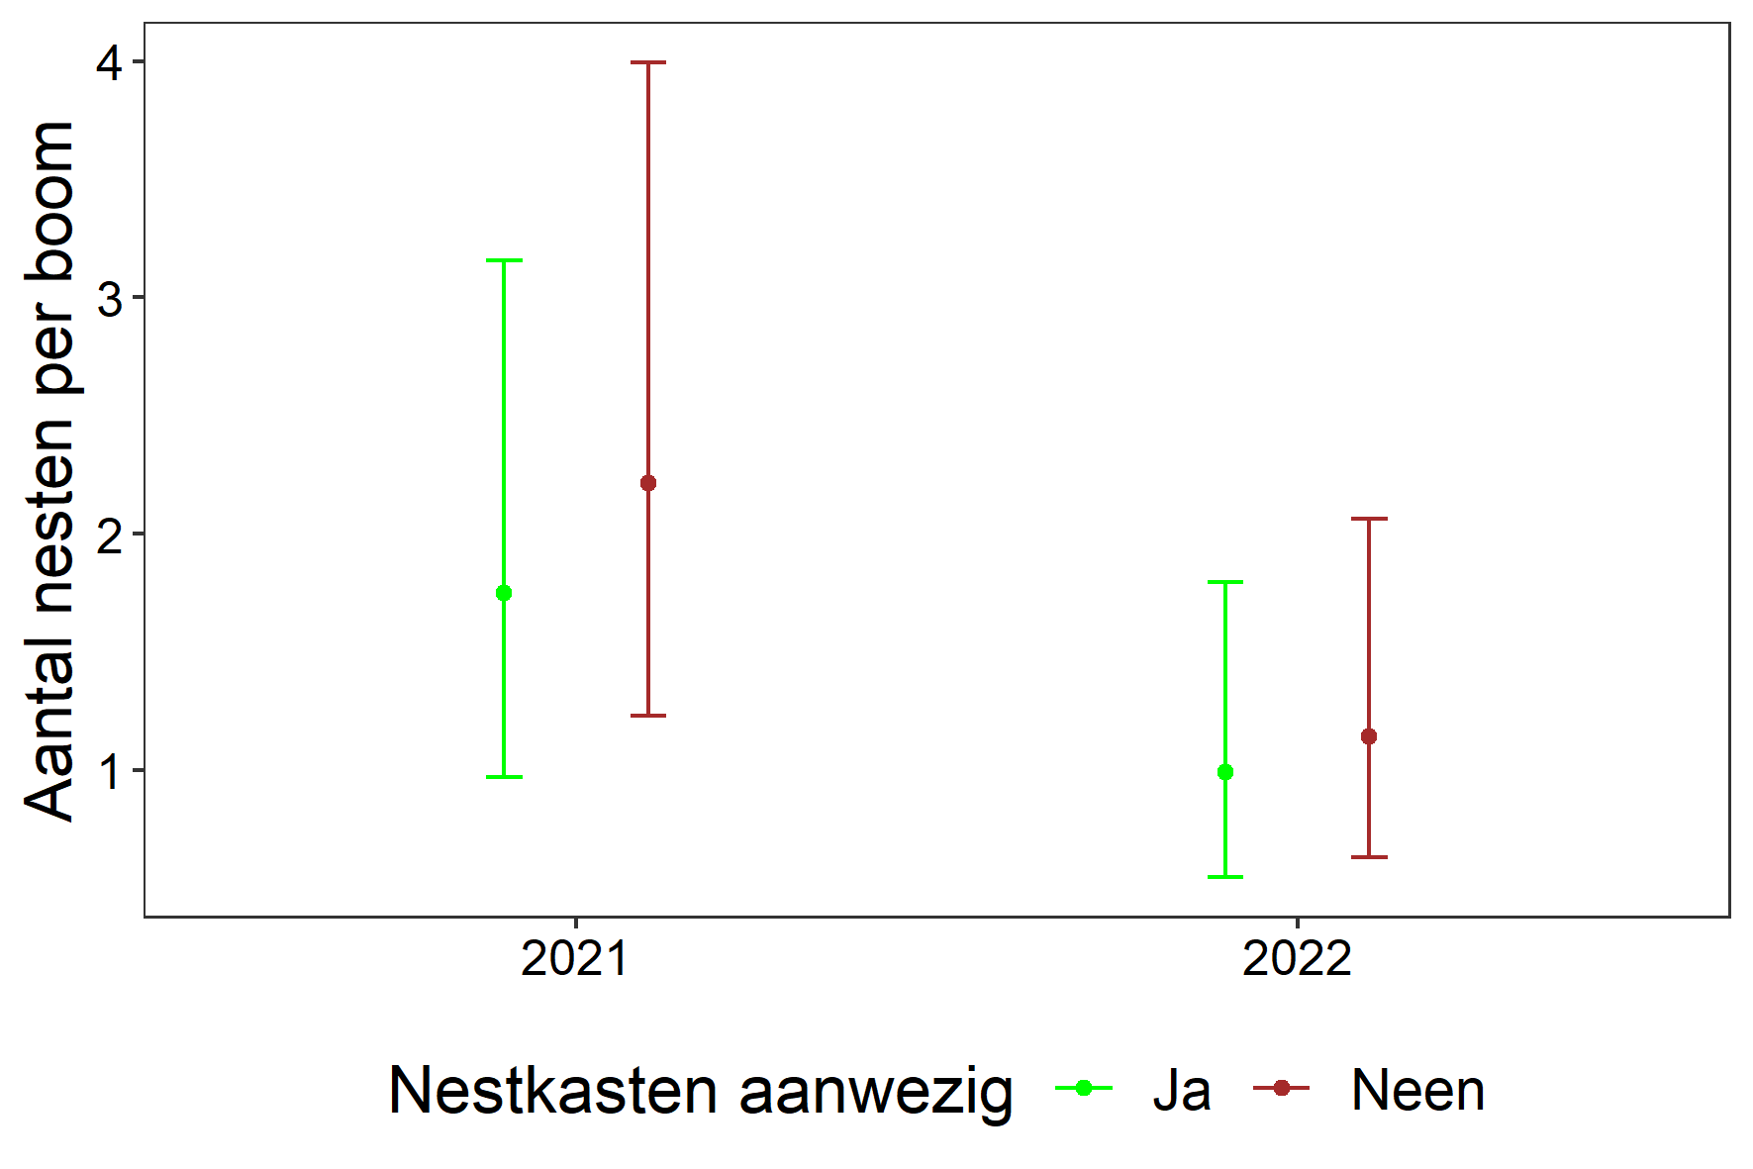
Number of nests per tree
Provincie | Gemeente | 2021 | 2022
Antwerpen | Merksplas | 0.7 | 1.4
Antwerpen | Retie | 6.1 | 4.6
Antwerpen | Wortel | 1.3 | 1.6
Gelderland | Arnhem | 4.2 | 5.8
Gelderland | Brummen | 3.6 | 15.3
Gelderland | Hall | 0.9 | 0.4
Gelderland | Klarenbeek | 1.1 | 0.8
Gelderland | Wageningen | 3.7 | 2.8
Limburg | Bree | 0.7 | 1.0
Limburg | Hechtel-Eksel | 0.3 | 1.5
Limburg | Kinrooi | 0.7 | 0.4
Limburg | Maaseik | 1.3 | 2.5
Noord-Brabant | Asten | 0.7 | 0.6
Noord-Brabant | Oud Gastel | 0.4 | 0.2
Noord-Brabant | Westerhoven | 1.5 | 1.2
Noord-Brabant | Zeeland | 0.3 | 0.3

Slide 21
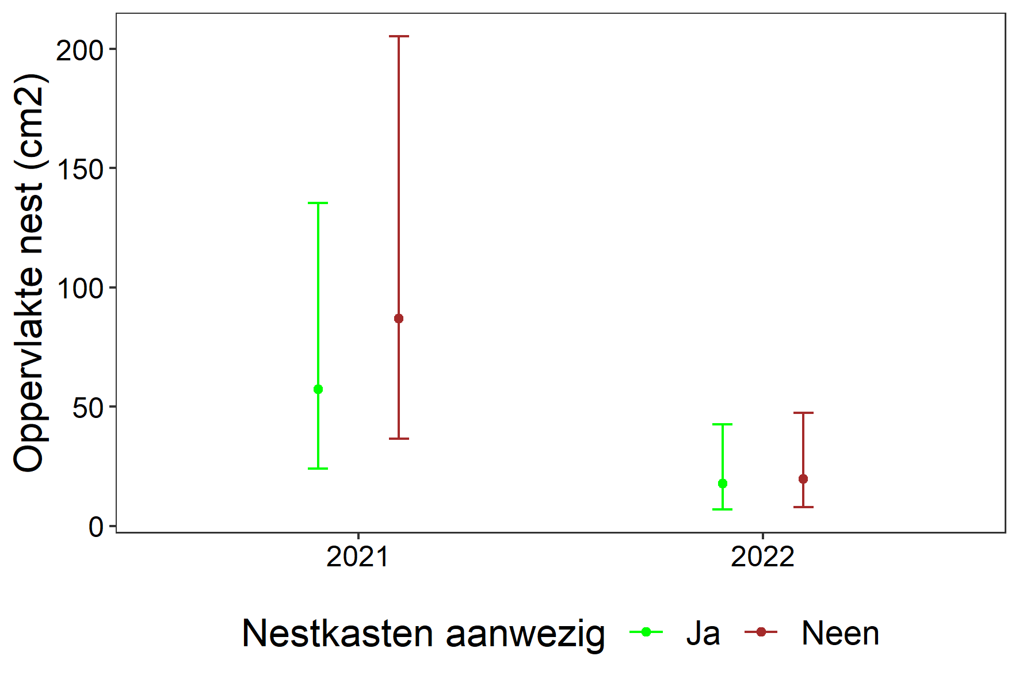
Nest area per tree
Provincie | Gemeente | 2021 | 2022
Antwerpen | Merksplas | -0.4 | 0.4
Antwerpen | Retie | 3.8 | 3.0
Antwerpen | Wortel | 0.7 | 0.0
Gelderland | Arnhem | 3.5 | 1.6
Gelderland | Brummen | 2.1 | 4.6
Gelderland | Hall | -0.4 | -2.2
Gelderland | Klarenbeek | 1.4 | -0.8
Gelderland | Wageningen | 1.6 | 0.5
Limburg | Bree | -0.4 | -0.1
Limburg | Hechtel-Eksel | -1.2 | 0.3
Limburg | Kinrooi | -1.0 | -1.1
Limburg | Maaseik | 0.3 | 0.3
Noord-Brabant | Asten | 0.4 | -0.6
Noord-Brabant | Oud Gastel | -3.0 | -3.5
Noord-Brabant | Westerhoven | 1.2 | 0.4
Noord-Brabant | Zeeland | -2.7 | -1.9

Slide 22
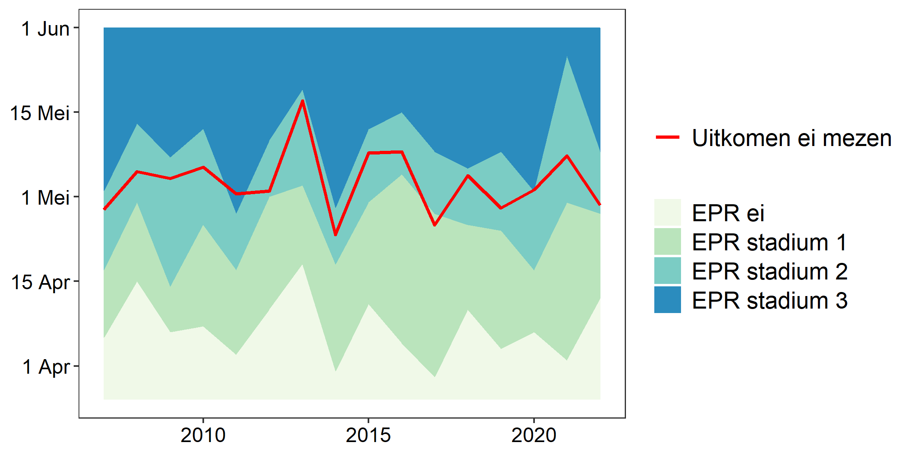
Synchronisation Oak Processionary caterpillars - tits

Slide 23
Agenda
Is the Oak Processionary Moth declining?
Ecological control of the Oak Processionary Moth
Tits as natural predators
Road verge management, parasitoid flies and wasps
Common Ivy - an unexpected sidestep
The Forest Caterpillar Hunter, back with a vengeance
Biocide use in Flanders and the Netherlands – on the way to a drastic reduction?

Slide 24
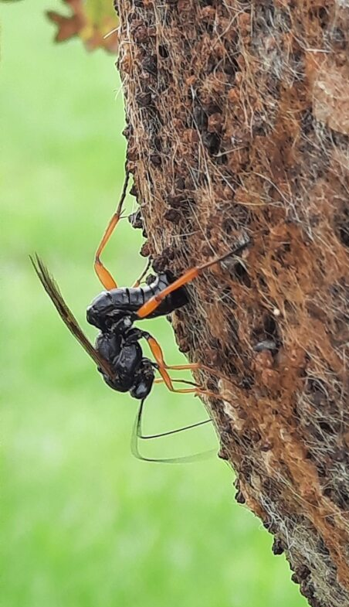
Parasitoid flies and wasps
Parasitoid flies and wasps parasitize OPM nests
Number of parasitoid flies and wasps highly dependent on the environment
Adjusted roadside management can lead to an increase

Slide 25
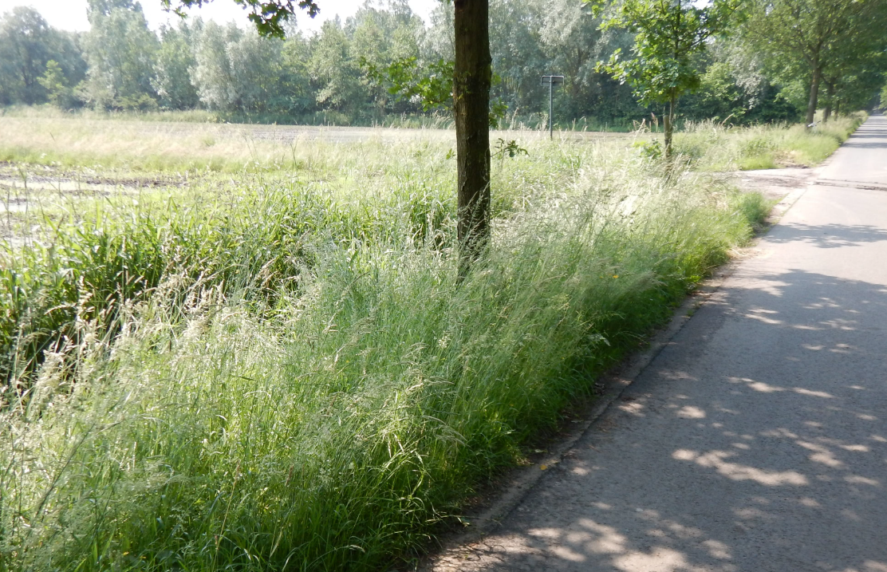
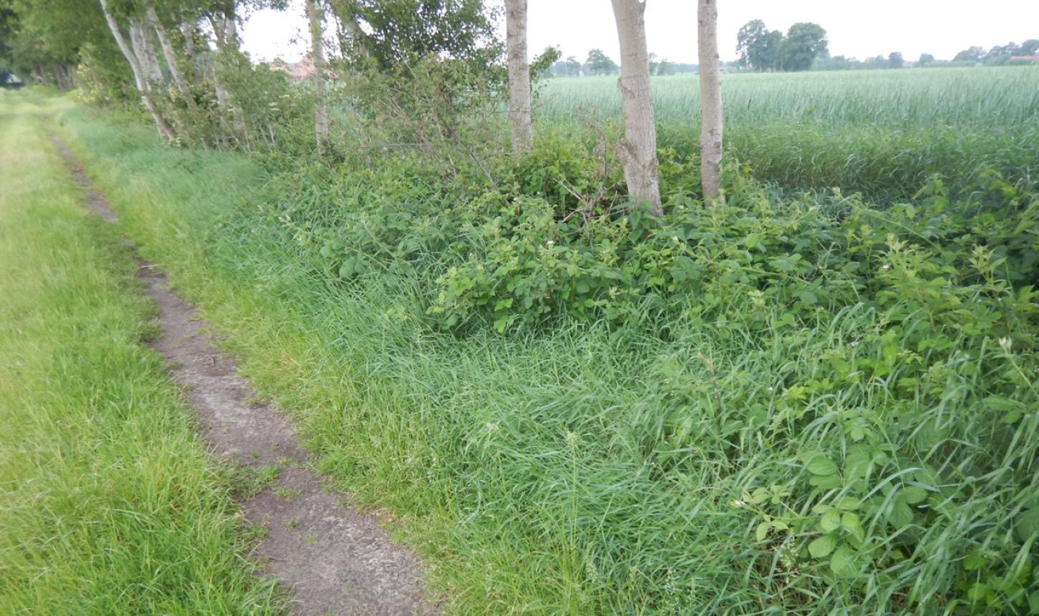
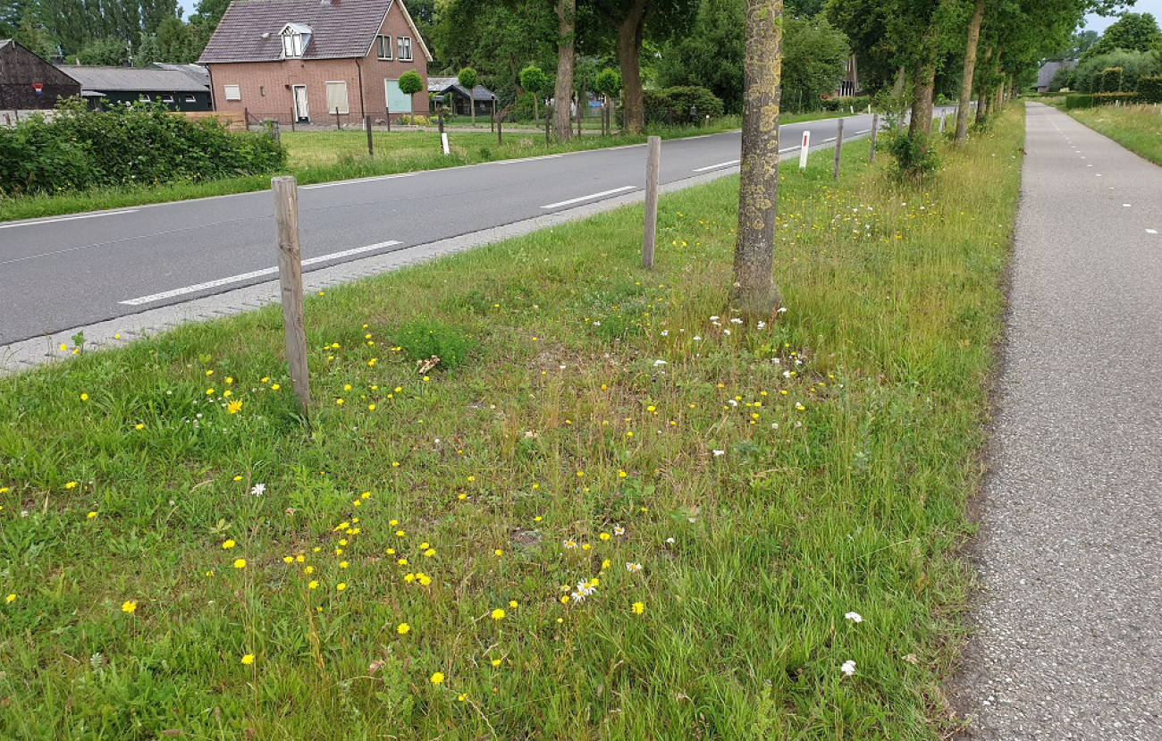
Parasitoid flies and wasps
55 Road verges spread over 4 provinces
grassy without herbs, mowed several times/year
flowery verge, without blackberries or other shrubs, mowed once/year
flowery verge, with blackberries or other shrubs, mowed once/year
sown verge with EPR seed mixture (NL), mowed once/year
rough grassy verge with nettles, mowed twice/year
phased mowed verge
Monitoring per test location:
Vegetation
Level of parasitization in OPM nests

Slide 26
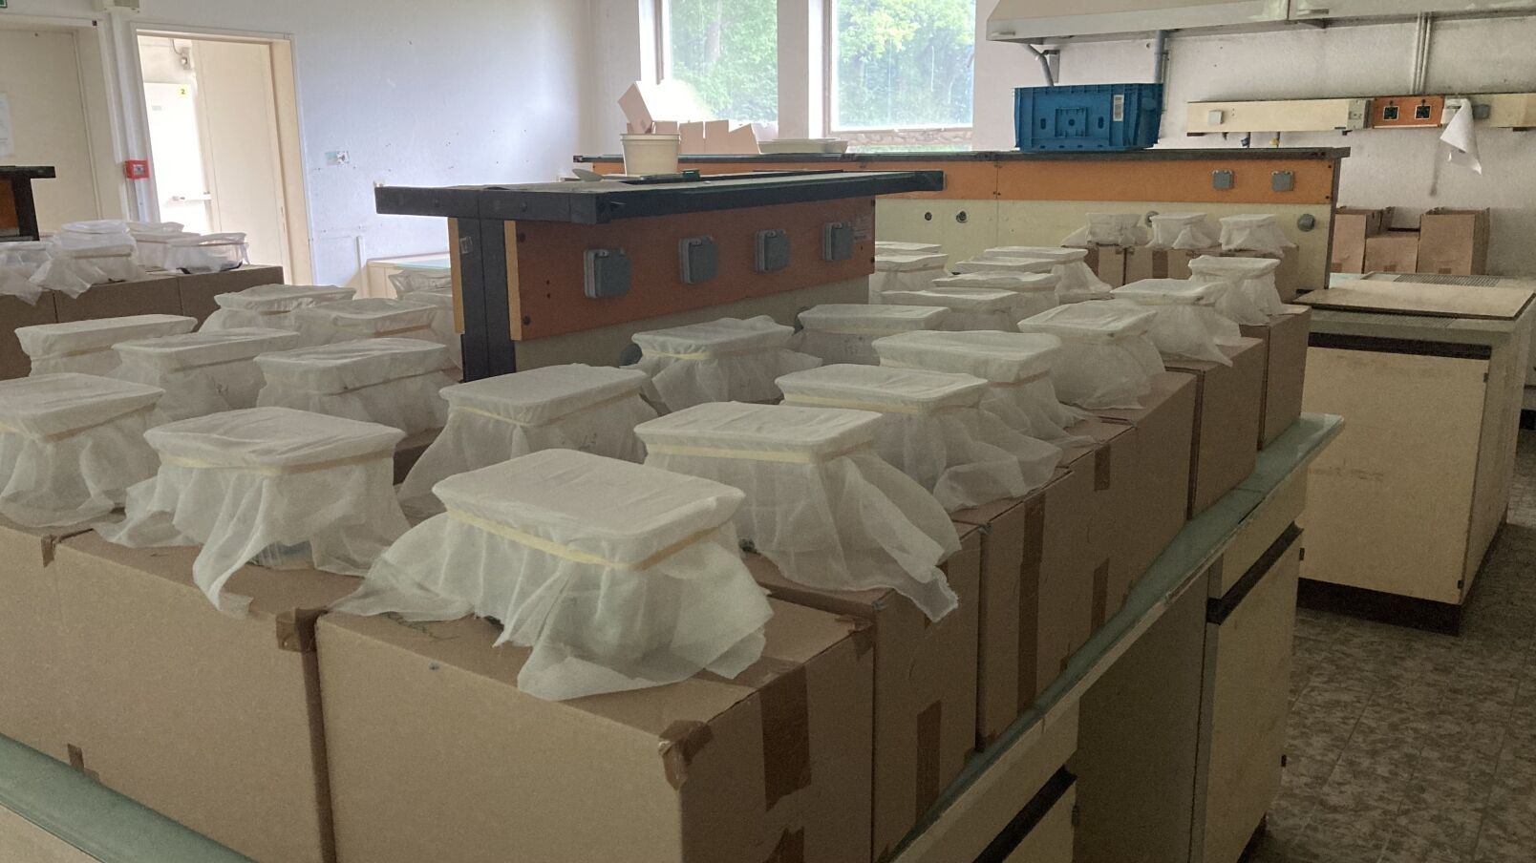
Parasitoid flies and wasps

Slide 27
Level of parasitizion by road verge type

Slide 28
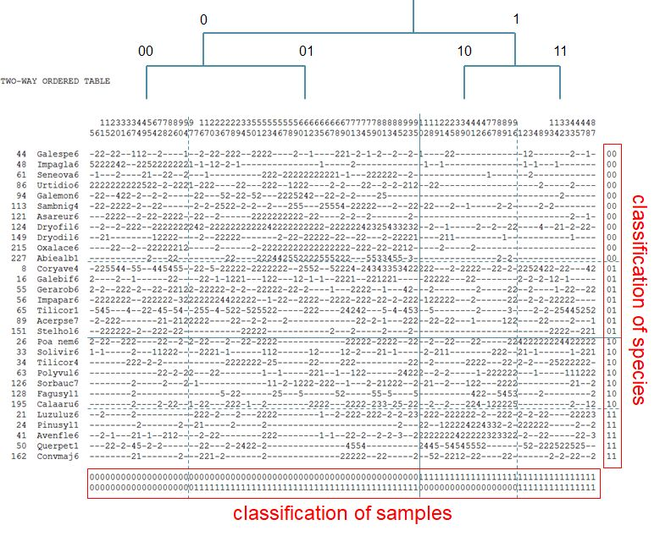
TWINSPAN
Classificatie soorten
Classificatie plaatsen

Slide 29
TWINSPAN
Yarrow
Narrow plantain
Common pigweed
Tansy
Common nettle
Blackberries
Blackberries
Common nettle
Red clover
White clover
Common trefoil
Chamomile
Vetch
Ragwort
Staghorn plantain

Slide 30
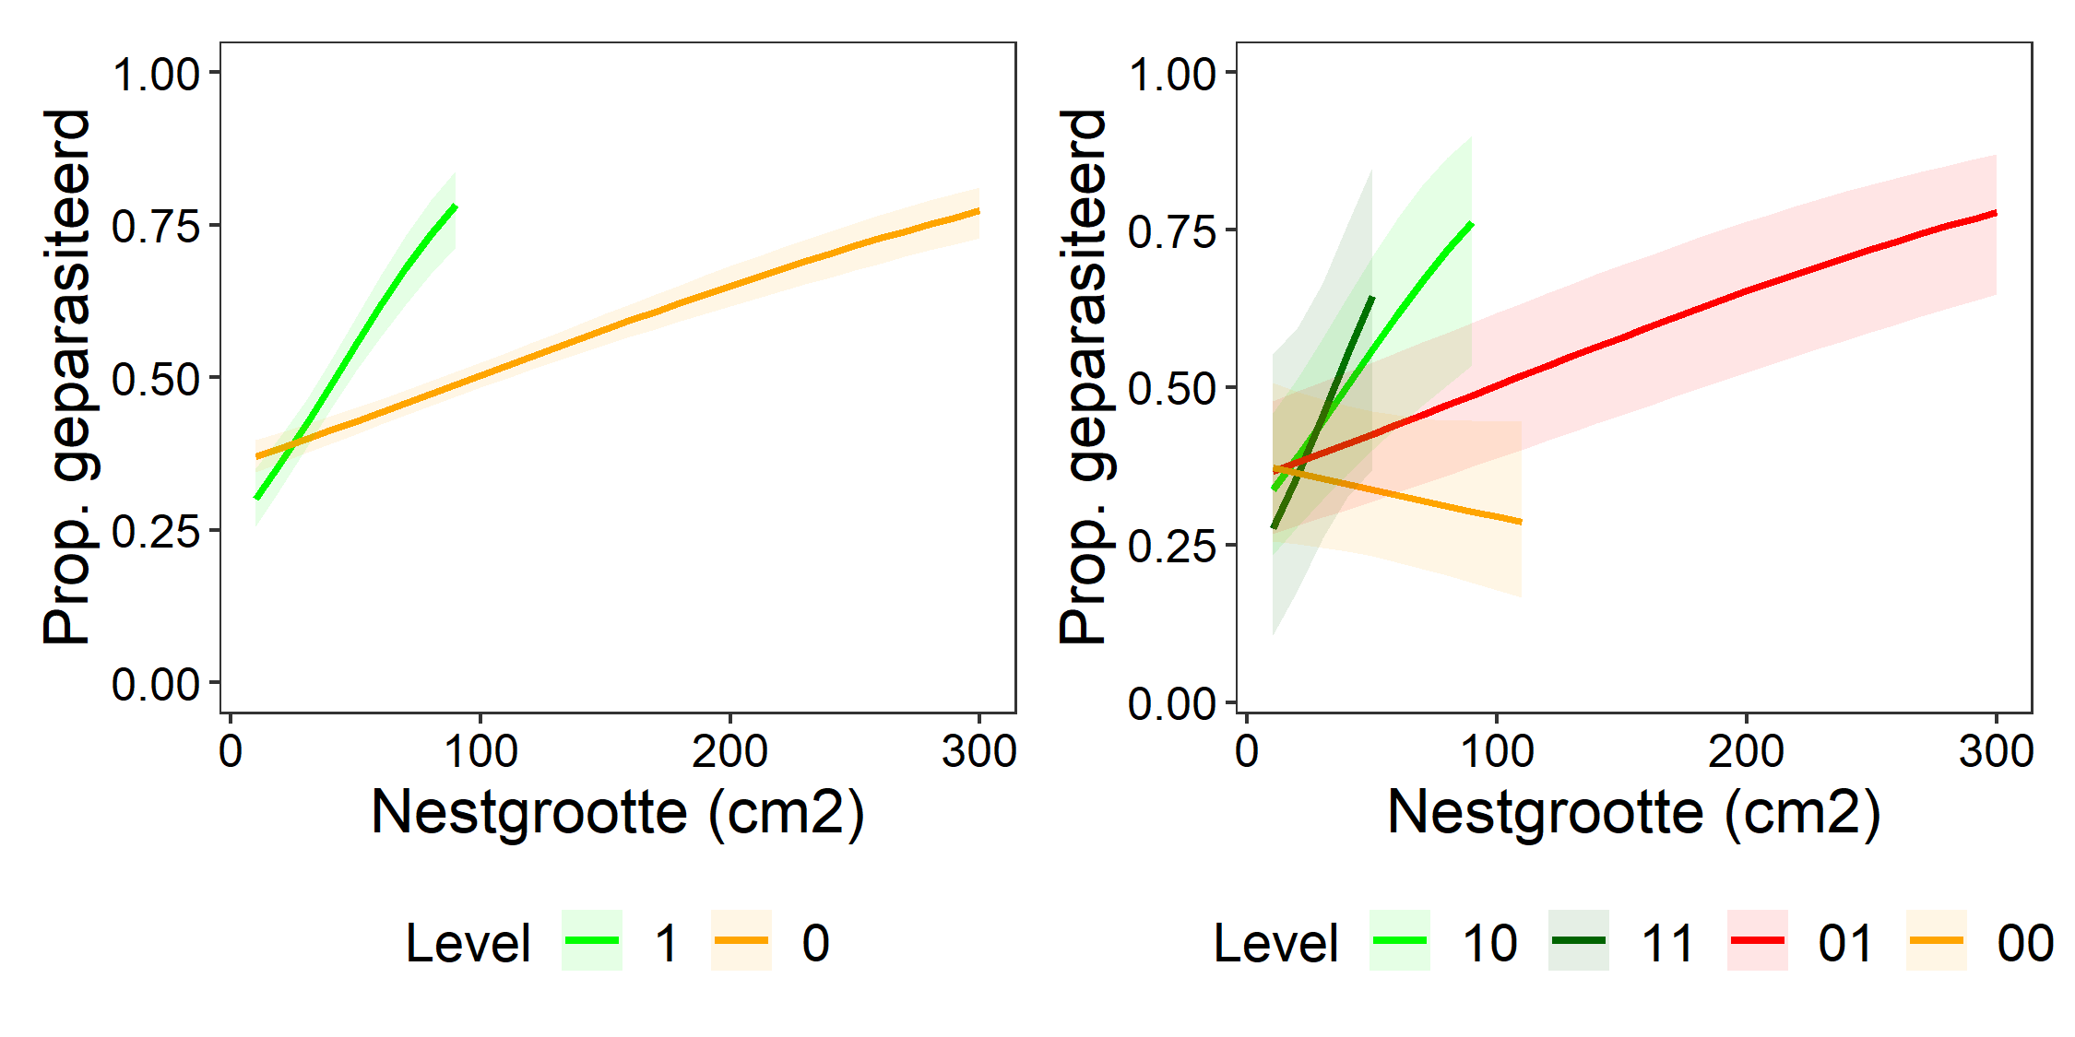
TWINSPAN

Slide 31
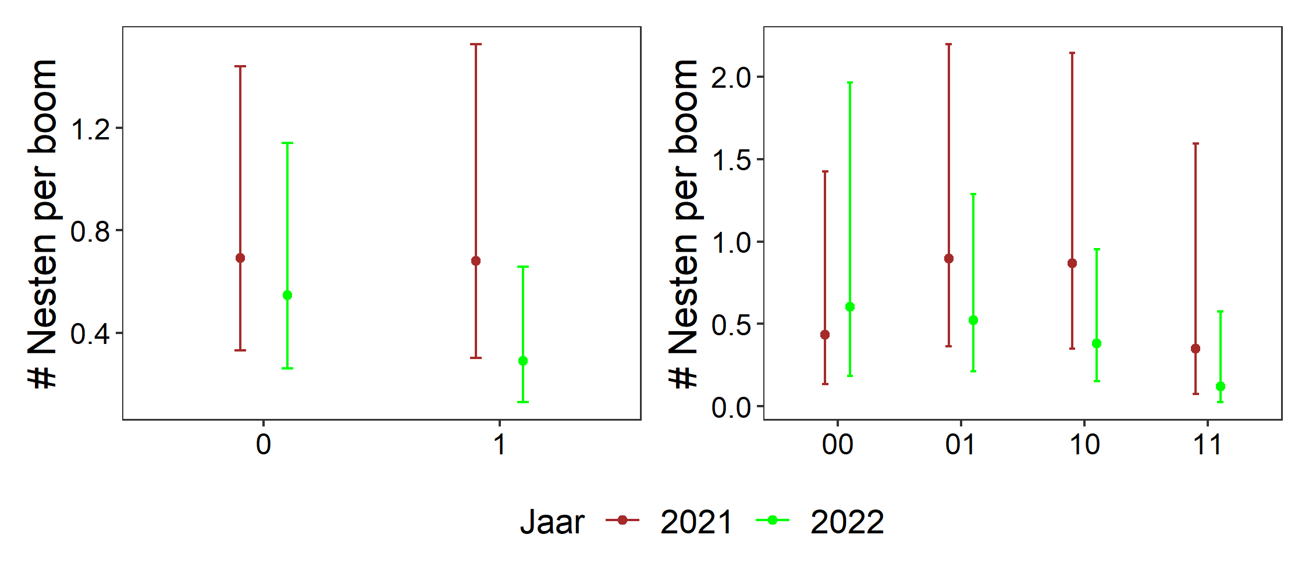
TWINSPAN

Slide 32
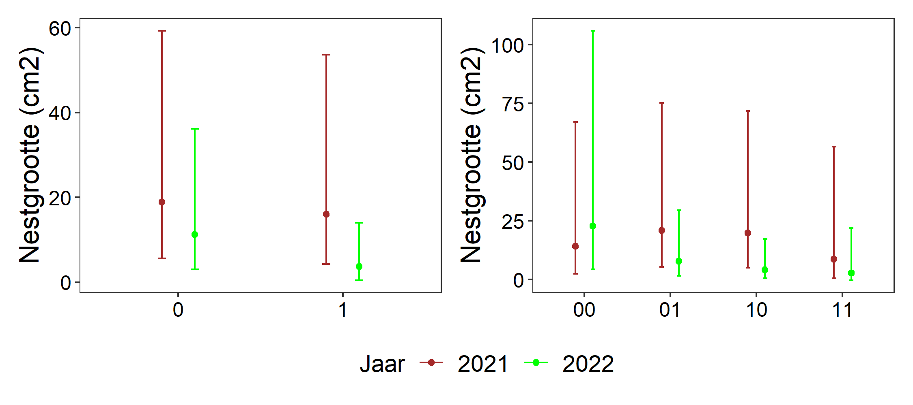
TWINSPAN

Slide 33
Agenda
Is the Oak Processionary Moth declining?
Ecological control of the Oak Processionary Moth
Tits as natural predators
Road verge management, parasitoid flies and wasps
Common Ivy - an unexpected sidestep
The Forest Caterpillar Hunter, back with a vengeance
Biocide use in Flanders and the Netherlands – on the way to a drastic reduction?

Slide 34
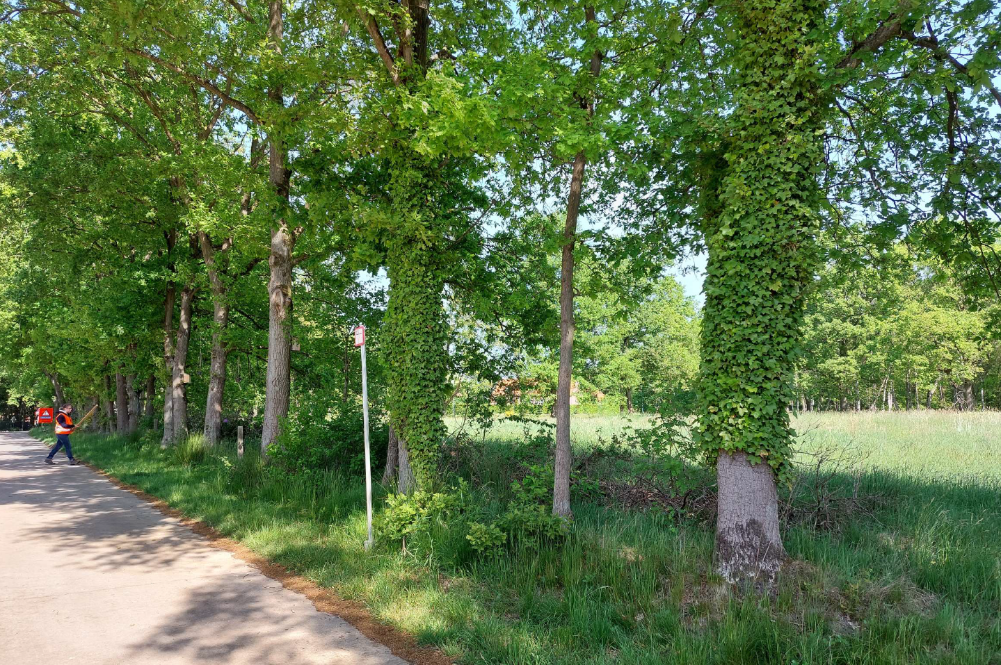
Common ivy - an unexpected sidestep
11 locations

Slide 35
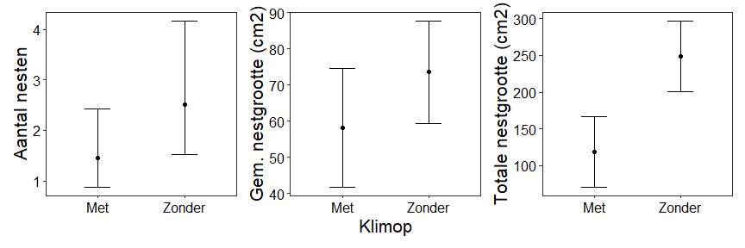
Impact of Common Ivy

Slide 36
Agenda
Is the Oak Processionary Moth declining?
Ecological control of the Oak Processionary Moth
Tits as natural predators
Road verge management, parasitoid flies and wasps
Common Ivy - an unexpected sidestep
The Forest Caterpillar Hunter, back with a vengeance
Biocide use in Flanders and the Netherlands – on the way to a drastic reduction?

Slide 37
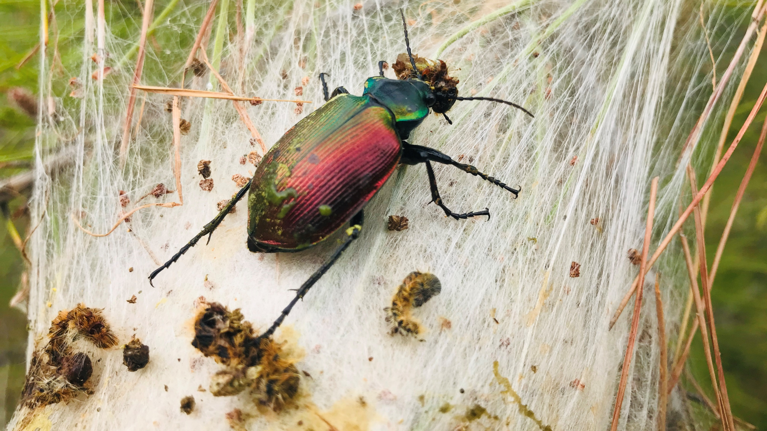
The Forest Caterpillar Hunter
Back with a vengeance - 2022 / 2023

Slide 38
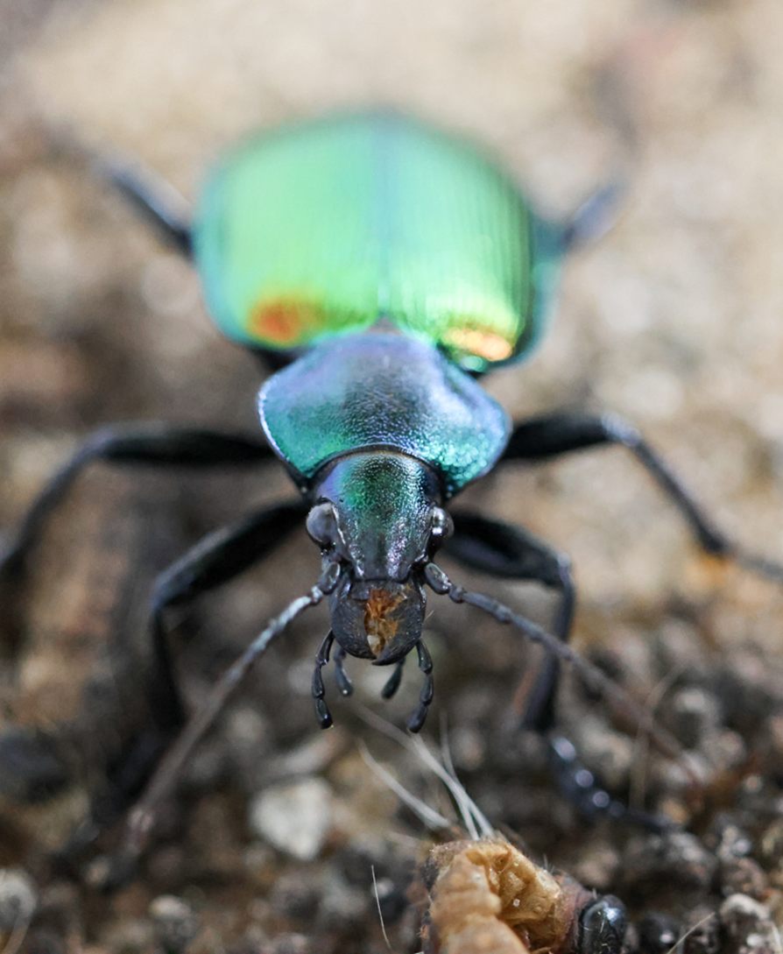
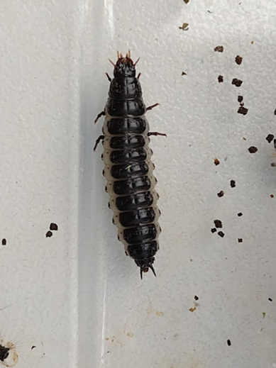
The OPM's biggest natural enemy
Both the larva and the beetle
Eat up to 11 caterpillars per day
First eliminates about 10 caterpillars
Large beetle, can live up to 4 years
Good flyer
Single observations in B/NL

Slide 39
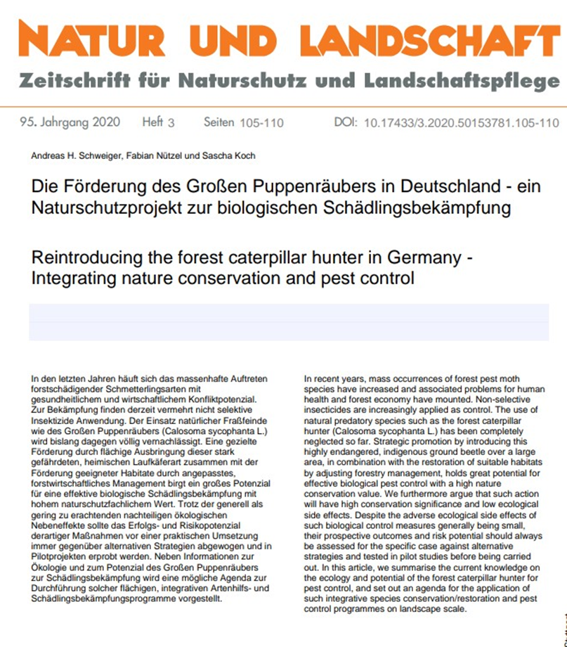
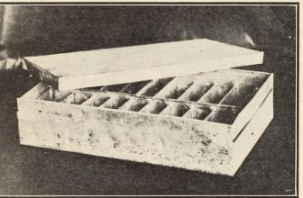
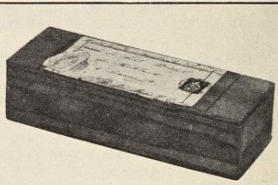
Known for a long time...
Introduced in 1909 in the US for natural control
Already suggested in 1990 in the Netherlands and recently in Germany

Slide 40
Actions taken
CS Opportunities Report
Habitat Model
Visit Turkey
Actions in the lab
Consultation

Slide 41
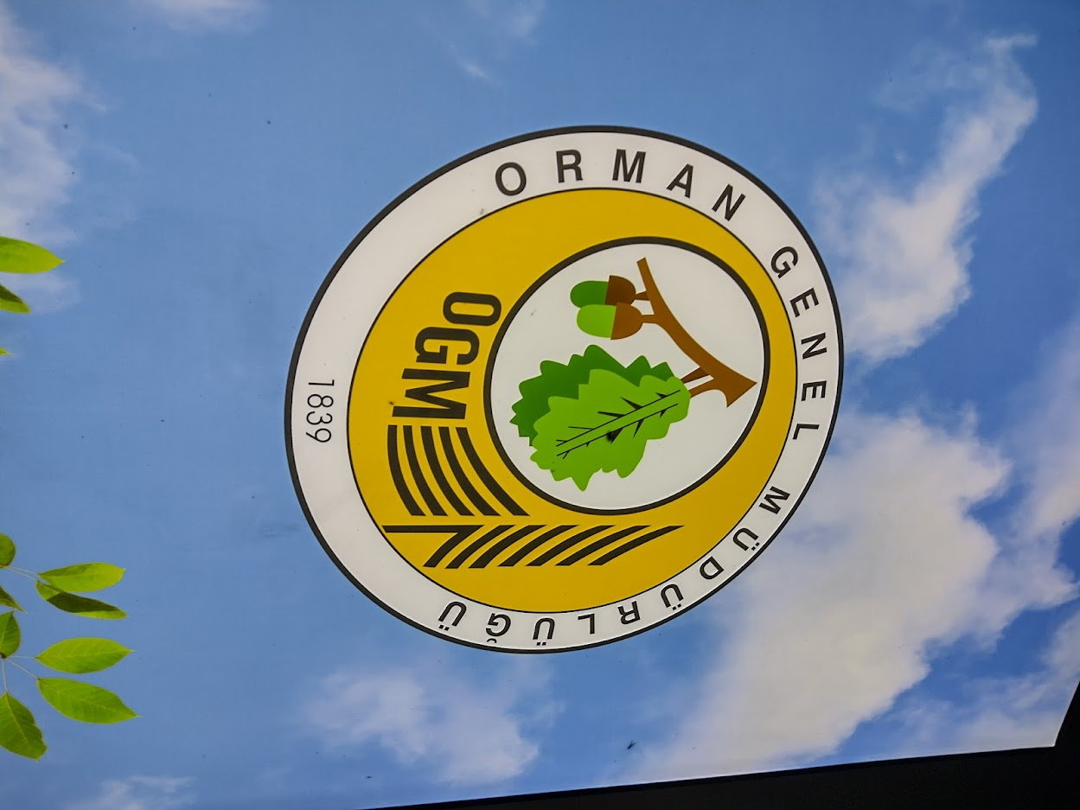
Training in Turkey 28.03 - 01.04.2022
Forestry Institute in Izmir
29 places where they breed CS for release

Slide 42
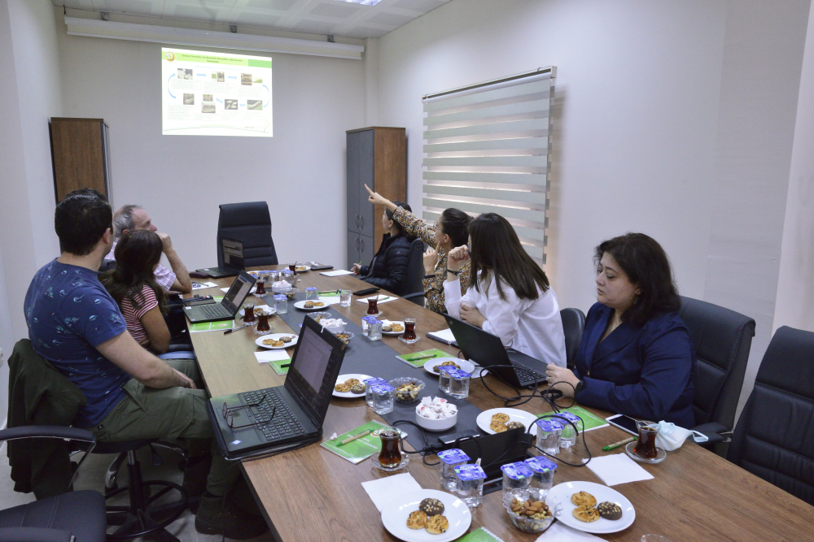

Slide 53
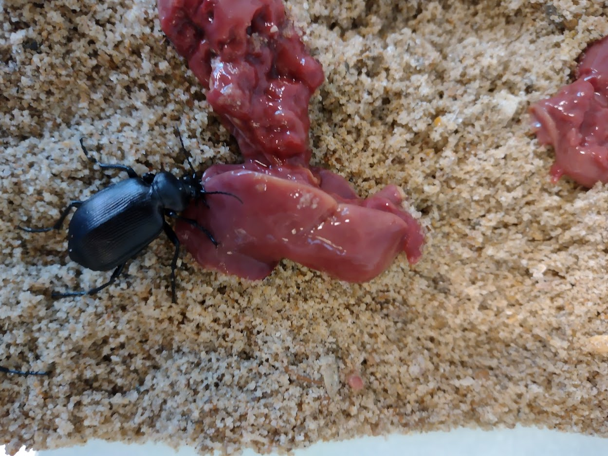

Slide 54
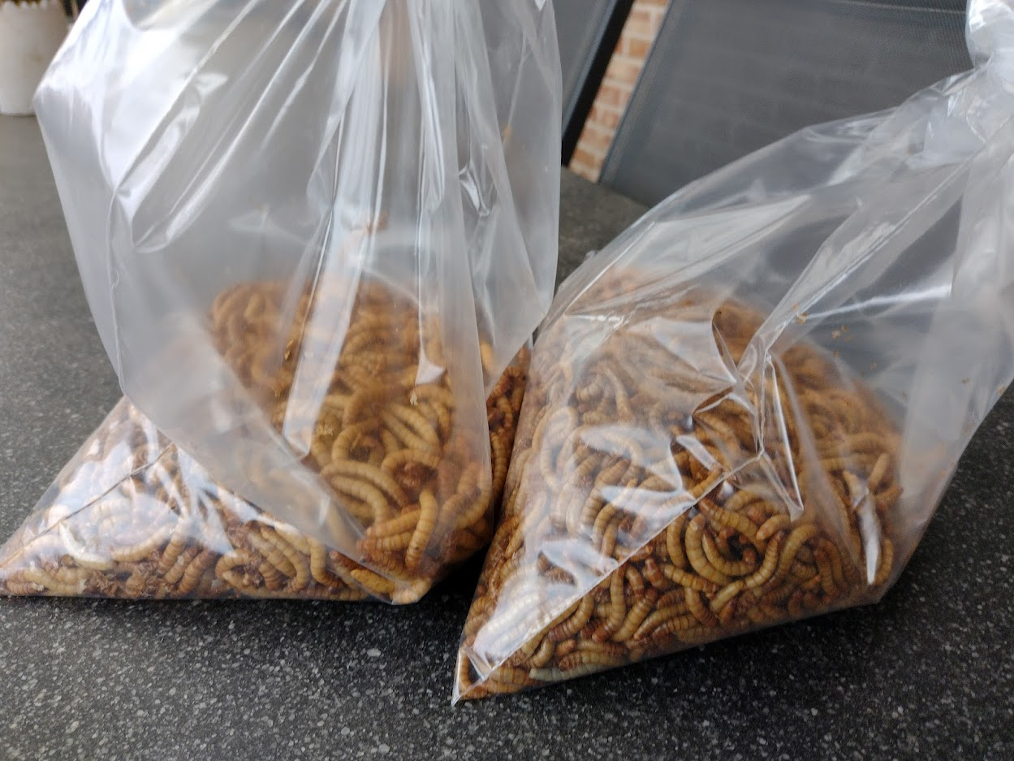

Slide 59
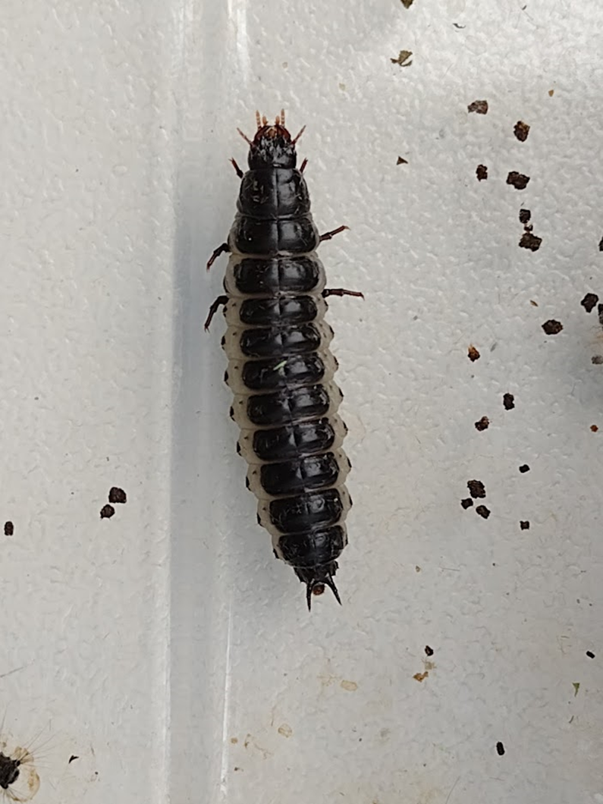

Slide 60
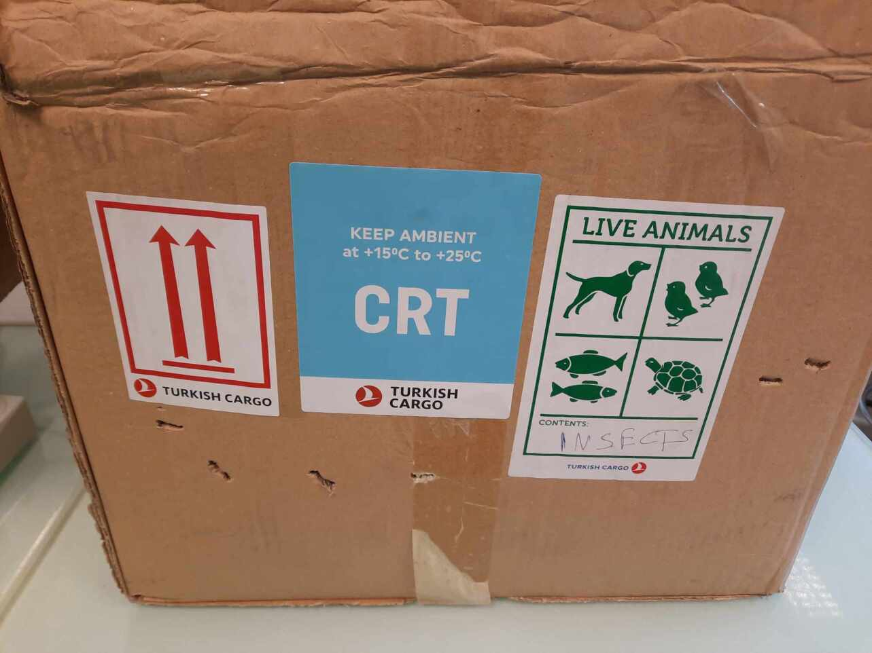
2023 nieuw actie
Nieuwe Poppenrovers uit Turkije van EPR gebied

Slide 64
Late arrival
Juni 26th 2023

Slide 65
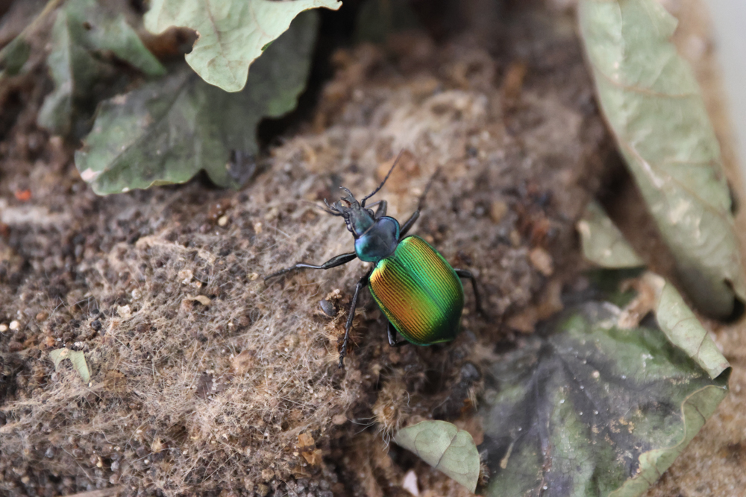
Late arrival

Slide 69
How to continue with the Forrest Caterpillar Hunter
Currently 92 beetles in the greenhouse
Hibernating underground
Woke up again in the spring and offered caterpillars in the lab
Hoping for offspring
Test remains under laboratory conditions

Slide 70
Agenda
Is the Oak Processionary Moth declining?
Ecological control of the Oak Processionary Moth
Tits as natural predators
Road verge management, parasitoid flies and wasps
Common Ivy - an unexpected sidestep
The Forest Caterpillar Hunter, back with a vengeance
Biocide use in Flanders and the Netherlands – on the way to a drastic reduction?

Slide 71
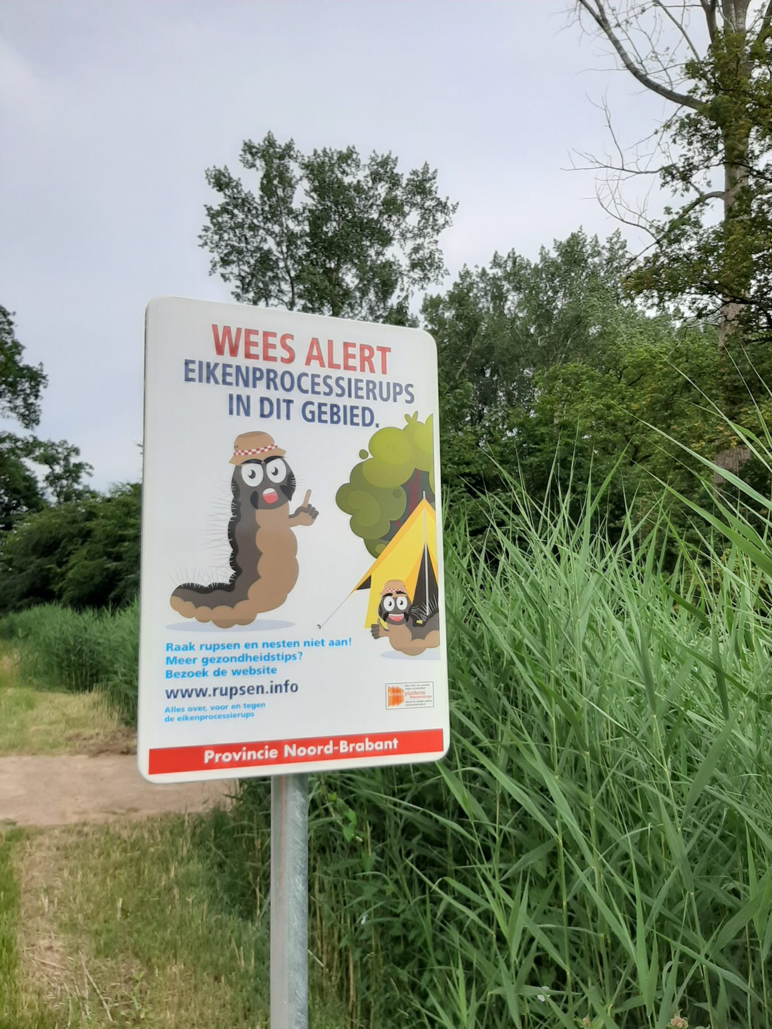
Biocide use in Flanders and the Netherlands
Main project objective:
Drastic reduction in the amount of biocides used in the fight against OPM
- 50% in the project area before end 2025
- 50% in Flanders & the Netherlands before end 2030
Indicators:
Extent of use (-> effect on the environment)
Number of trees sprayed
Amount of biocide used (in kg or l)
Effectiveness of the biocide (-> percentage of OPM and other species impacted)
Amount of active substance used (in kg)
Potency (biological effect) in IU or MIU

Slide 72
Information sources
Biocides used by door de project partner
All municipalities in the provinces of Limburg & Antwerp (BE) ;
Provinces of Gelderland & Noord-Brabant (NL) on provincial roads;
Municioalities Sittard-Geleen, Maastricht and Heerlen in Limburg (NL);
Baseline 2018: 2053 l/kg
Annual VMM-data (Flanders)
All Flemish municipalities & higher authorities
Data as from 2011
Baseline 2018: 1581 l/kg
Ambassador municipalities:
Annual survey sent out by the project
At least 4 municipalities per province (NL + BE)
Data as from 2020
Baseline 2021: 32,4 l/kg

Slide 73
Biocides used
Bacillus thuringiensis (BT)
Three variants
Impact on all caterpillars – not just OPM
Most commonly used
Product | BT subspecies | Nature | Active substance (kg/kg or kg/l) | Potency (IU/mg)
Xentari WG | Bacillus thuringiensis aizawai | Solid | 0,03 | 15.000
Foray 48B | Bacillus thuringiensis kurstaki | Liquid | 0,14 | 10.600
Foray ES | Bacillus thuringiensis kurstaki | Liquid | 0,03 | 17.600
NeemProtect
Extract of the Neem or Margosa plant (Azadiracta indica)
Impact on all leaf-eating insects
Very limited use

Slide 74
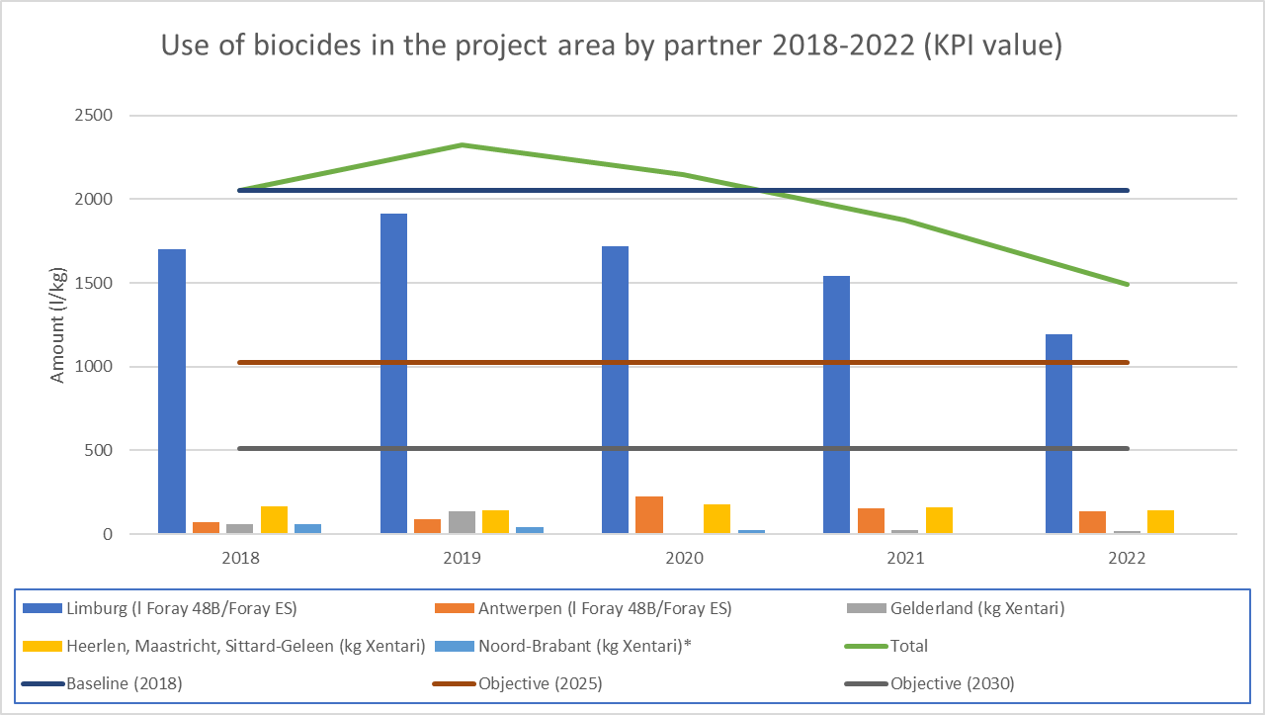
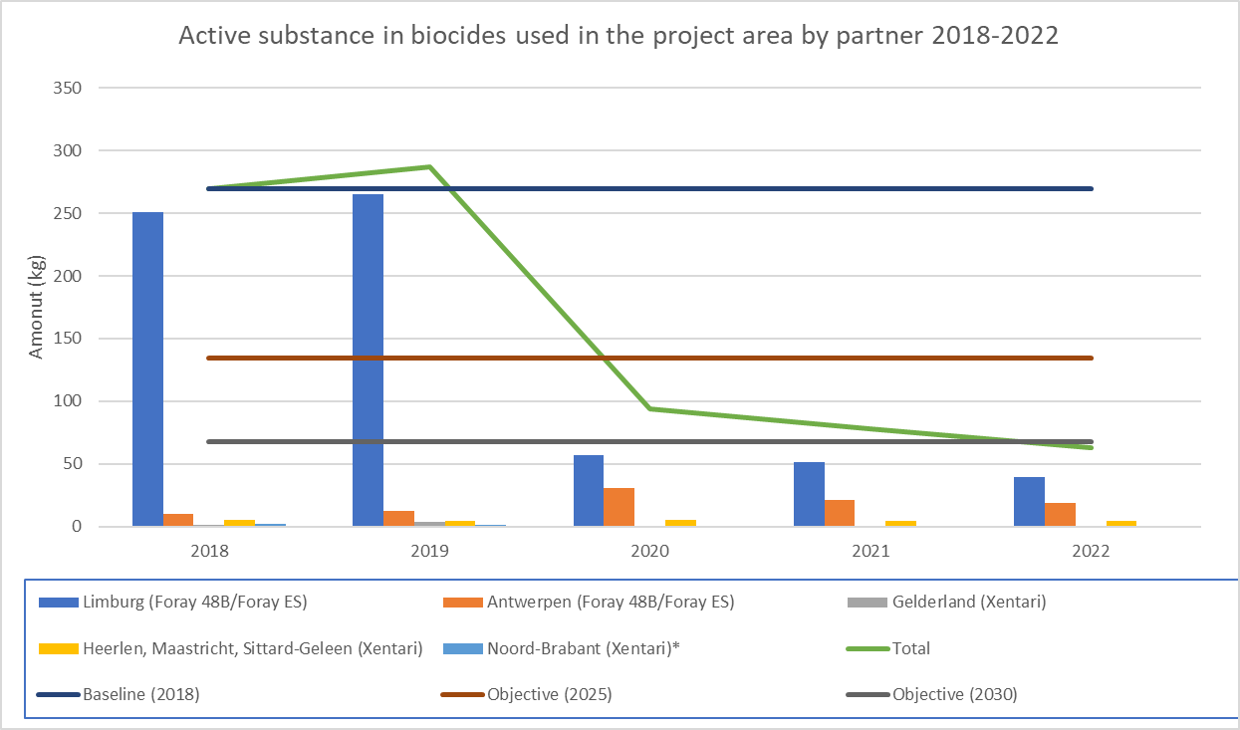
Biocide use by project partners

Slide 75
Biocide use in Flanders (VMM)

Slide 76
Biocide use by Ambassador municipalities

Slide 77
Preliminary conclusions
Reduction of the amount of biocides used (KPI) in the majority of provinces in line with the target
Increasing awareness of the negative effects of biocides
Relatively limited presence of OPM since 2022
Strong reduction of the impact on the ecosystem through the introduction of a new product variant
However: The use of biocides may increase again with future OPM peaks
Continuous awareness remains necessary

Slide 78
More info? Questions? Comments?
Website: Home - LIFE Oak Processionary Project
Facebook: EikenprocessierupsLIFE
E-Mail: info@eikenprocessierups.life

Slide 79
Where are we after 2,5 years? (1/2)
Trend Oak Processionary: 2023 quiet, 2024 comparable?
Predation by tits:
No clear impact of tits on oak processionary caterpillars yet;
Tit chicks too late in the season to take advantage of young caterpillars;
Research continues.
Predation by parasitoid flies and wasps:
Promising results in terms of impact on the Oak Processionary Moth;
No clear connection yet with the type of road verge, management or nectar index;
Research is refined into plant species and continued.

Slide 80
Where are we after 2,5 years? (2/2)
Common ivy in pedunculate oak:
First results show a significant impact on Oak Processionary Moths;
Research continues;
Possible impact on other species is being investigated.
Predation by forest caterpillar hunter:
Lab tests show that they prefer oak processionary caterpillars as food;
If a breeding can be started, we see possibilities for controlling the caterpillars;
Further research in the laboratory and then outside (if there are sufficient caterpillars) is certainly necessary;
Currently, the population of beetles in the Benelux is too small to have an impact.
Biocide use in Flanders & the Netherlands:
Decreases almost everywhere in Flanders and the Netherlands since 2021;
Risk of relapse when pressure increases -> awareness remains important.

